Slide 1
Equity Payouts: Dividends and Share Repurchases
What can a company do with its earnings?
Retain them and then either spend or reinvest
Pay off liabilities
Pay dividends
Cash
Property (rarely): stock dividends and spinoffs of shares of a subsidiary
Repurchase shares from shareholders
Market transaction
Directly (tender offer)

Slide 2
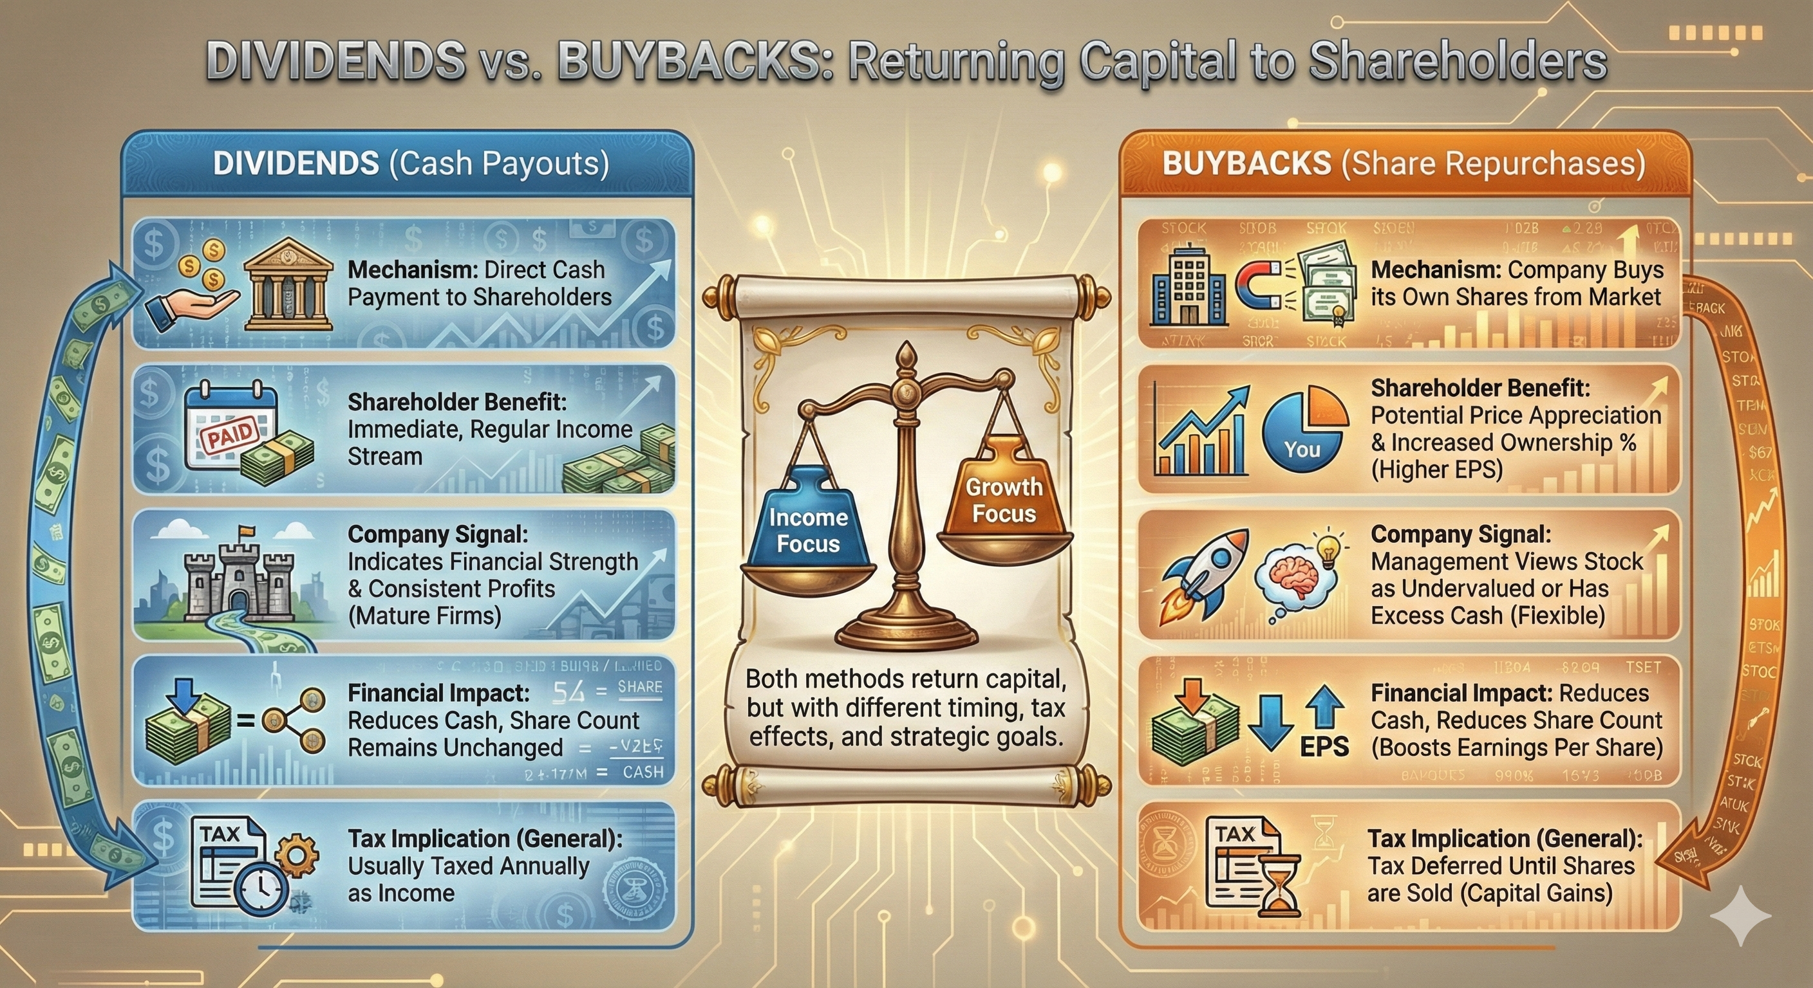
Beta Slide: Dividends v. Buybacks

Slide 3
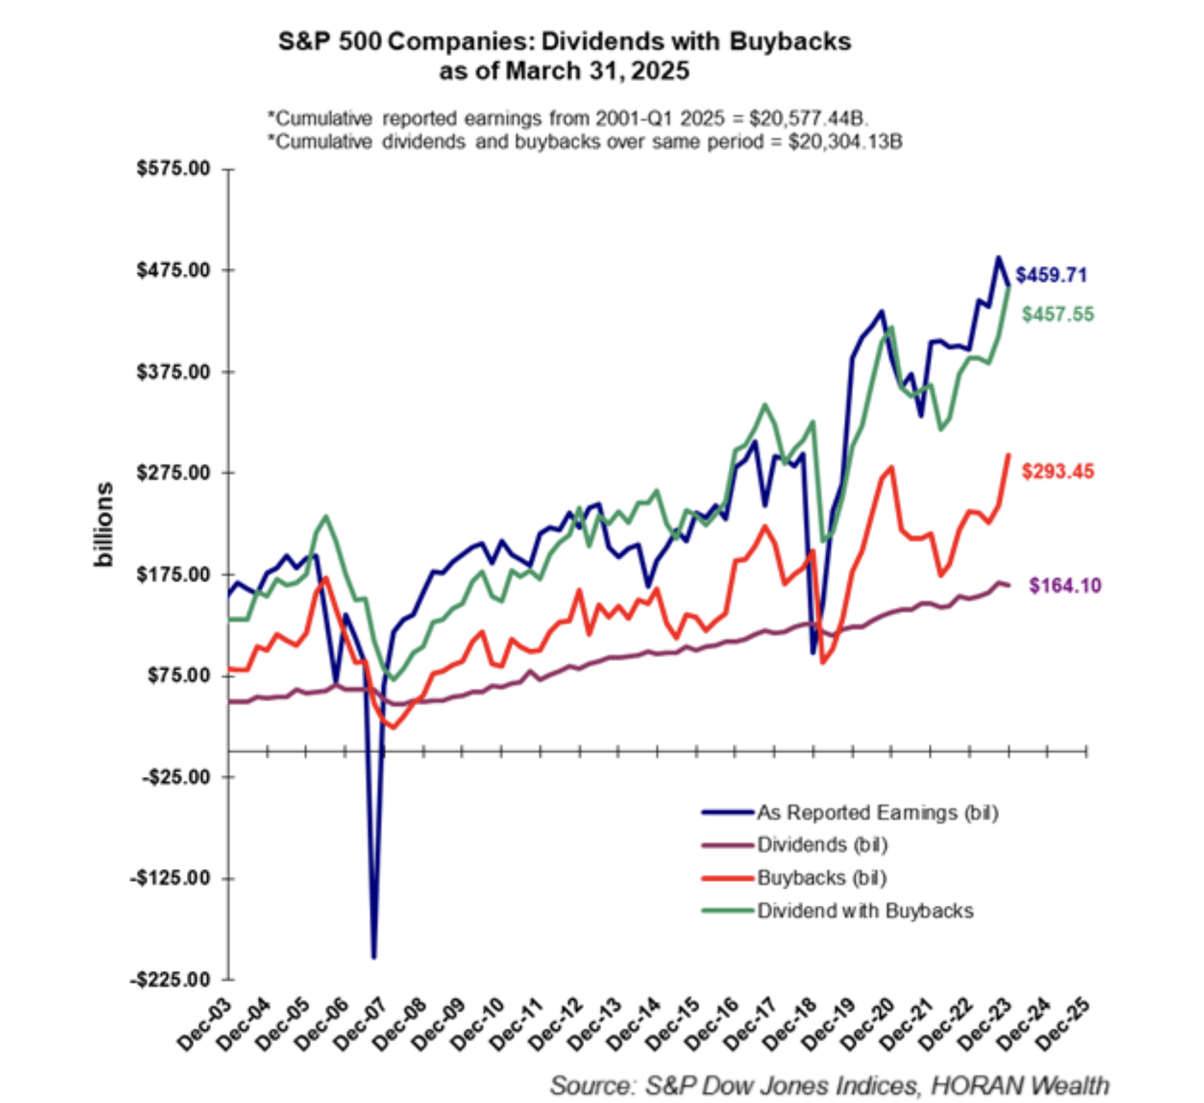
S&P 500, Dividends, & Buybacks
Source: Horan Wealth

Slide 4
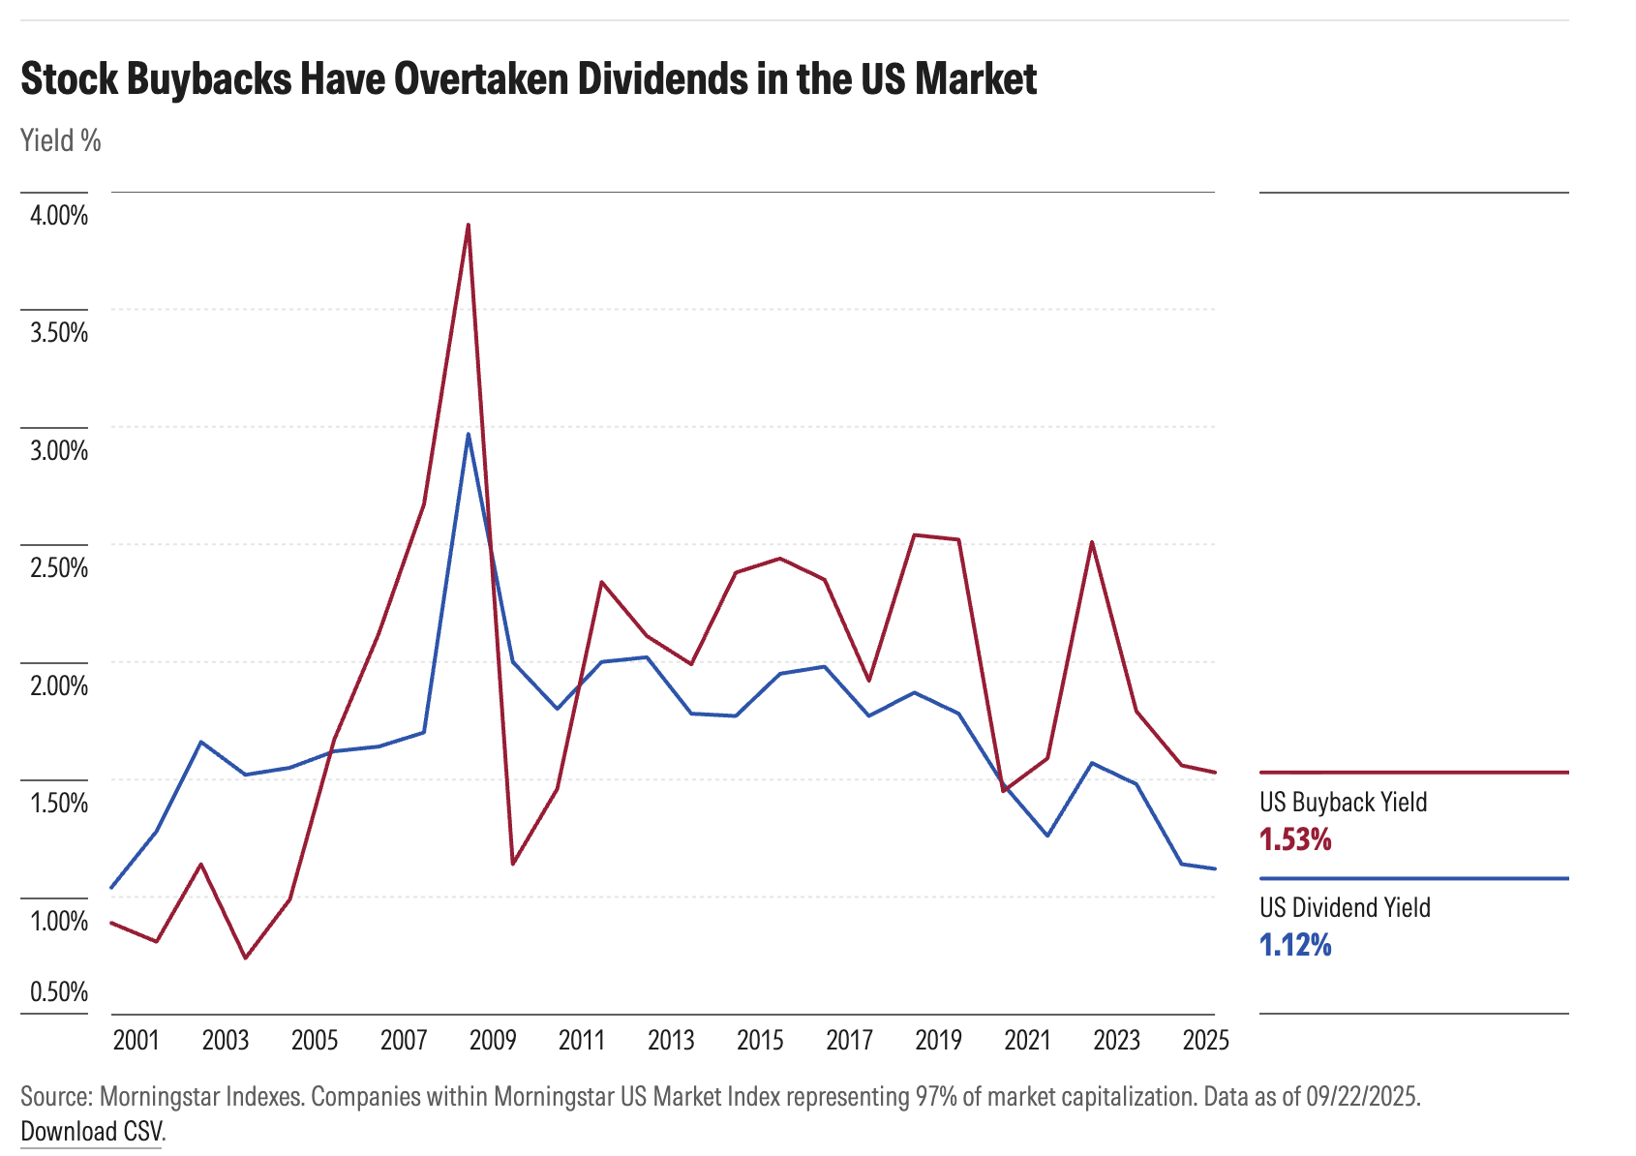
US Stocks, Dividend & Buyback Yields
Source: MS 2025

Slide 5
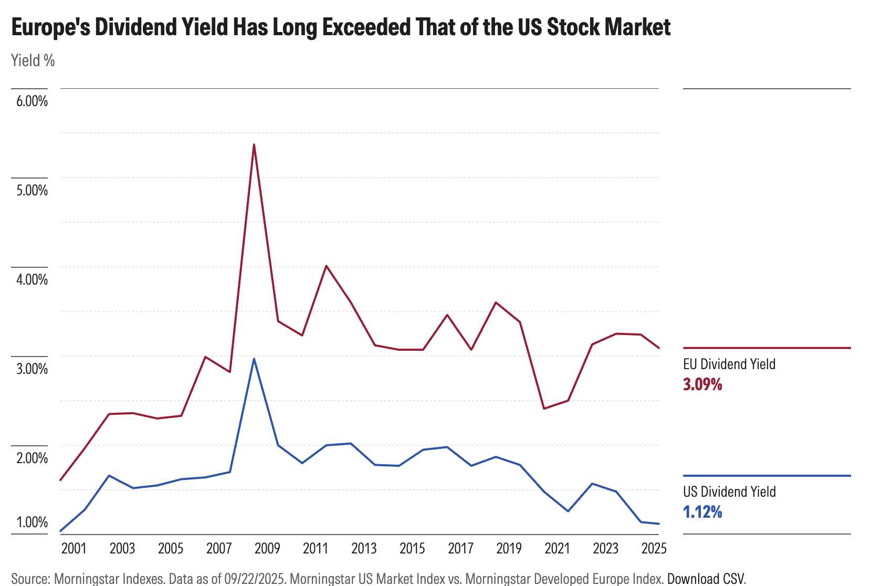
Europe, Dividends, & Buybacks
Source: MS 2025
Source: MS 2025

Slide 6
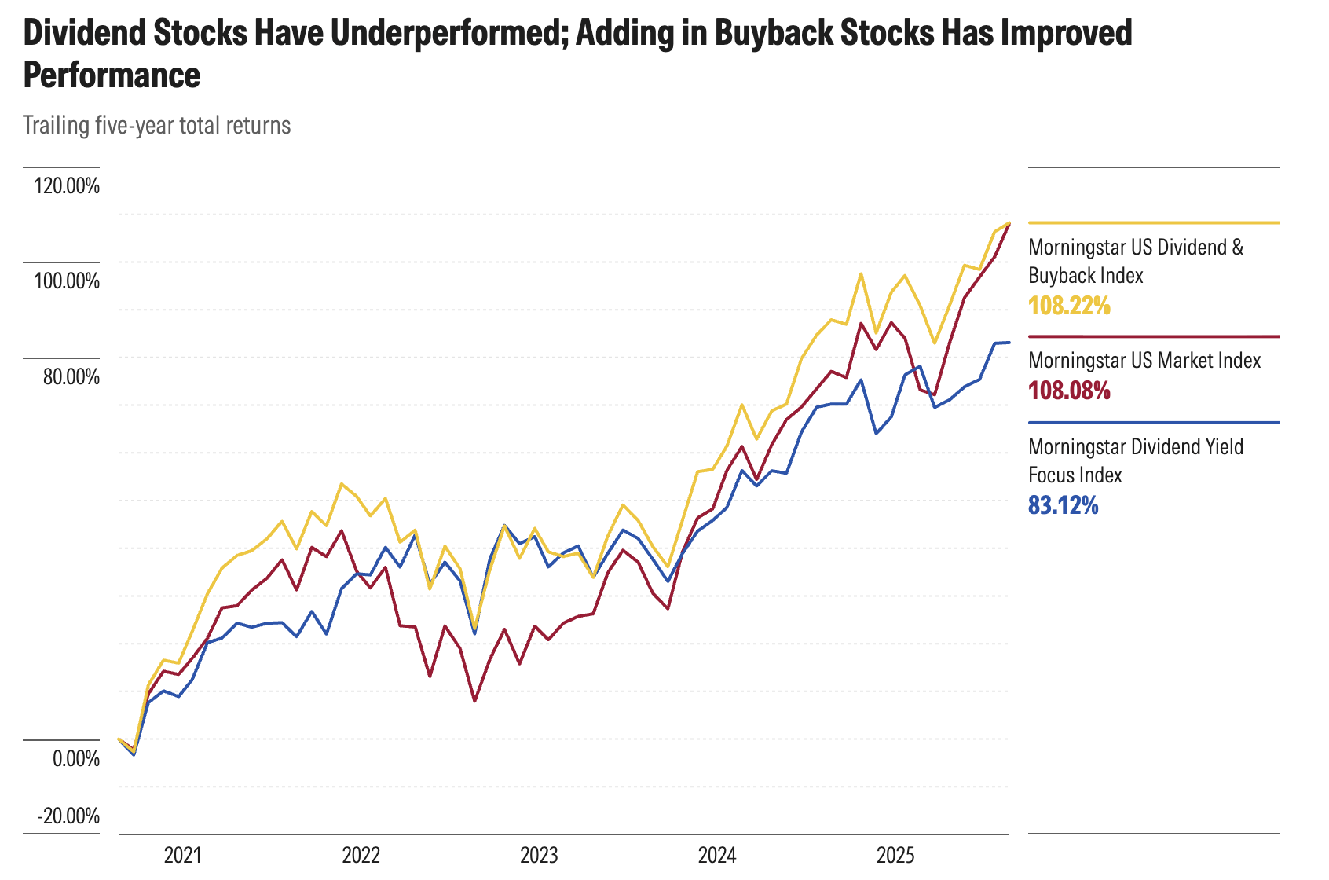
Dividends, Buybacks, & Stock Performance
Source: MS 2025

Slide 7
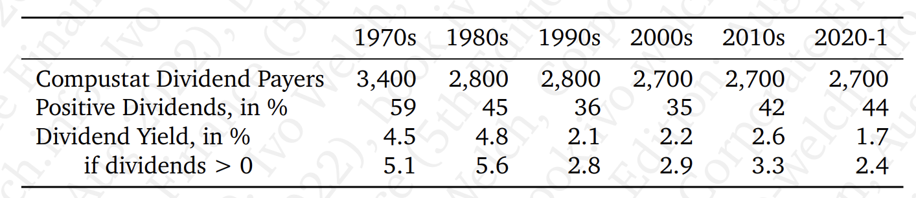
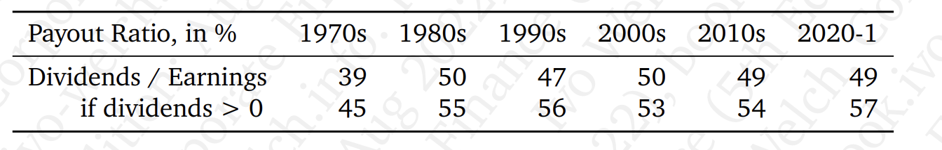
Dividends

Slide 8
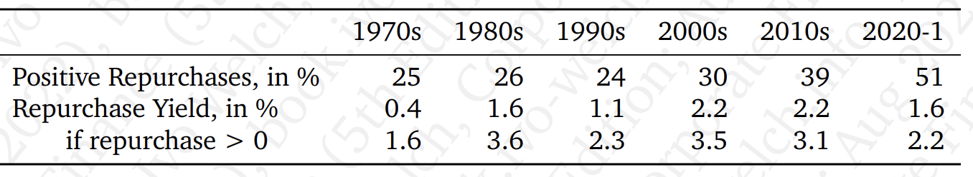
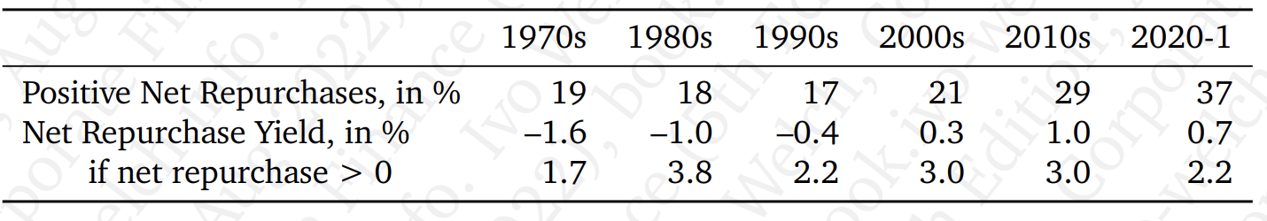
Buybacks

Slide 9
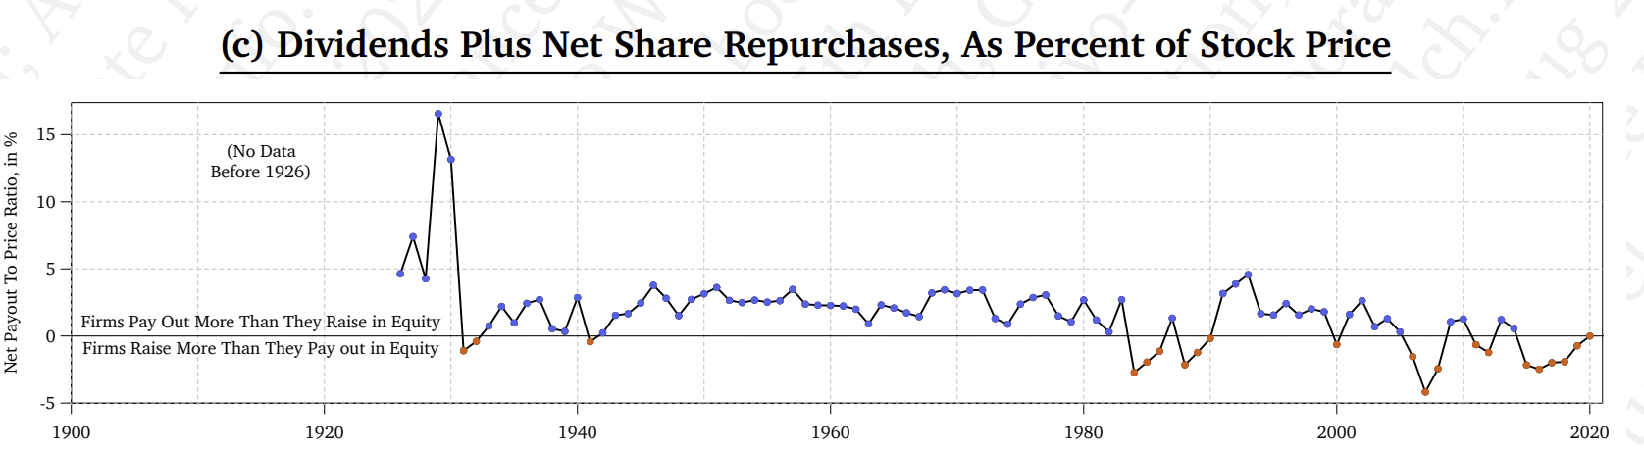
(Dividends + Net Share Repurchases) /Stock Price

Slide 10
Dividend
Pro rata distribution to shareholders (but preferred dividends to prd shareholders)
Cash or (rarely) property
On October 15, 2025, Costco announced that its Board of Directors has declared a quarterly cash dividend on Costco common stock of $1.30 per share. The quarterly dividend is payable November 14, 2025, to shareholders of record at the close of business on October 31, 2025.
Declaration (announcement) date [10/15]
Cum-dividend date [10/30]
Ex-dividend date [10/31]
Record date [10/31]
Payment date [11/14]
T+1 Settlement
Stock splits and reverse stock splits
Price effects?

Slide 11
Stock Repurchases
Auction-based repurchase
Private negotiations
Open-market Repurchase (most common)
The company announces a new $20 billion share repurchase program to replace its existing authorization and expects to utilize the new authorization over an approximate two-year period. Walmart (Oct. 2017)
Rule 10b-18 Safe Harbor (very, very abbreviated)
Must purchase all shares from single broker on any single day
Limits on when during the day purchases can be made
Limits on the purchase price
Can’t exceed 25% of ADTV over prior 4 weeks
SEC’s Share Repurchase Disclosure Modernization Rule vacated by 5th Cir in Dec. 2023
Where can you find information about share buybacks on the financials?

Slide 12
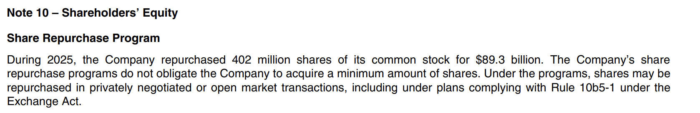
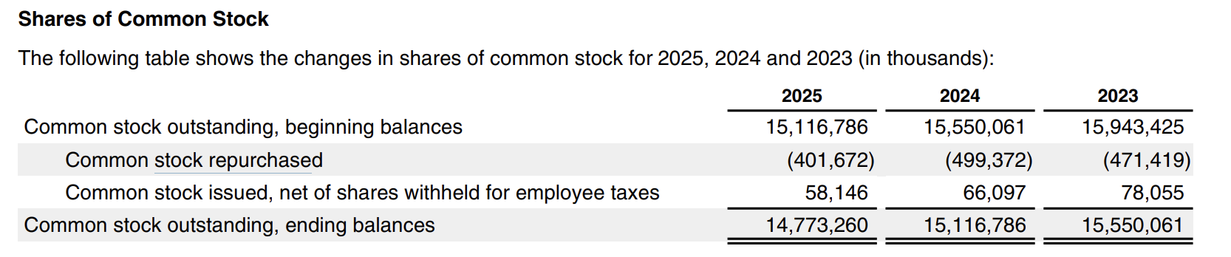
Apple FY 2025 10-K

Slide 13
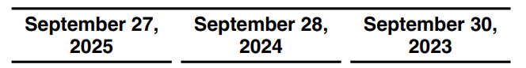
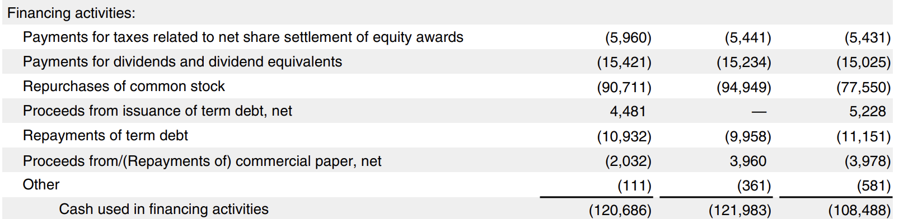
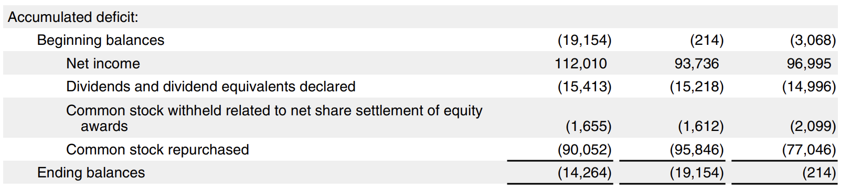
Apple FY 2025 10-K: CF (Financing); Retained Earnings

Slide 14
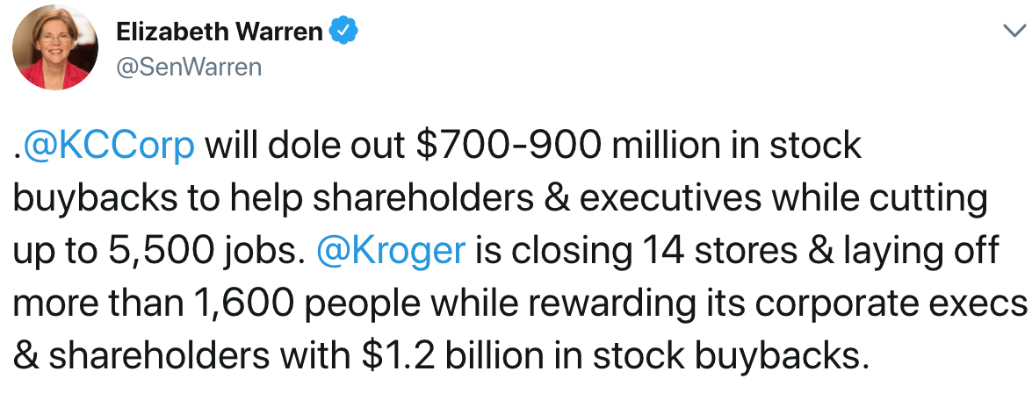
Political Concerns with Buybacks

Slide 15
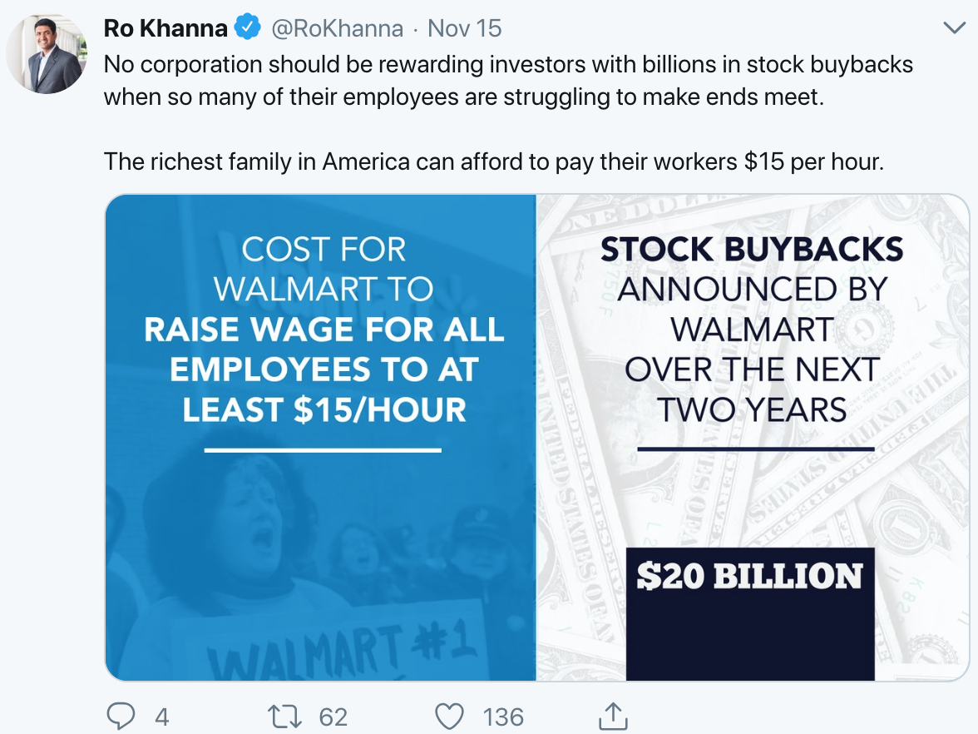
Political Concerns with Buybacks

Slide 16
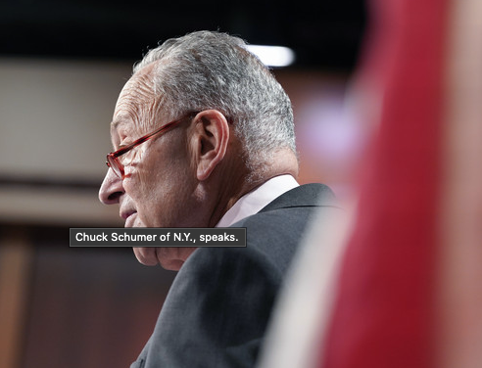
Political Concerns with Buybacks
“I hate stock buybacks,” Senate Majority Leader Chuck Schumer (D-N.Y.) said Friday. “I think they’re one of the most self-serving things that corporate America does. Instead of investing in workers and in training and in research and in equipment, they simply — they don’t do a thing to make their company better and they artificially raise the stock price by just reducing the number of shares.”
Politico (8/5/22)

Slide 17
Bad financial understanding makes bad laws
IRC §4501, enacted as part of the Inflation Reduction Act (2022), imposes a 1% excise tax on the FMV of any stock repurchased by a covered corporation, which is any US publicly traded corporation.
Applies to transactions treated as redemptions under §317(b) and economically similar transactions.
Excise Tax = 1% * (Repurchased Stock – Qualifying Property – Issuances – Repurchases treated as Dividends)
De minimis exception: annual buybacks 1MM or less
Revenue Estimate: 78Bi over the next 10 years

Slide 18
Buybacks going up, up, up?
Source: Asness (2018)

Slide 19
Companies are selling assets to fund buybacks
Source: Asness (2018)

Slide 20
Companies are forgoing investments to fund buybacks

Slide 21
Dividends & Repurchases
In a perfect market, payout policy doesn’t matter. M&M II
Q: Would you pay more for a stock that promised a 2% dividend vs. a stock that promised a 1% dividend? What if you wanted more $ each year?
But: market Imperfections…
Corporate taxes
NEW for 2023: 1% excise on the FMV of buybacks by publicly traded corporations
Personal taxes
Dividend rate vs. CG rate: 23.8%
Dividend vs. Repurchase:
Dividend: Entire amount taxable; CG: only taxed on gain portion (above cost)
Clienteles (tax-exempt (foreigners, pensions, IRA, 401(k)s) and taxable investors)
CGs still offer significant flexibility—realization requirement; can decide which shares to sell
Financial distress
Agency and Signaling
Reduce possibility of investment in bad project (like debt)

Slide 22
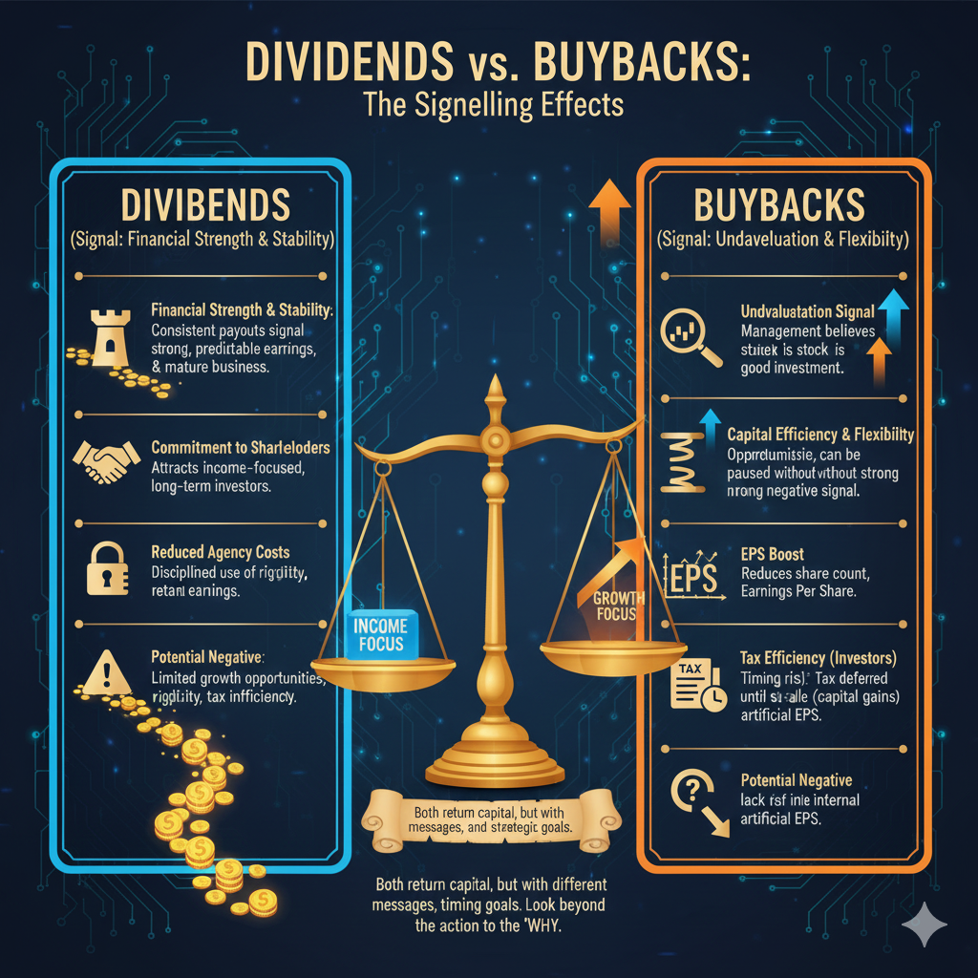
Beta Slide: Buybacks vs. Dividends: Signaling

Slide 23
Naive Conceptions
Buybacks help remaining SHs because there are now fewer shares outstanding.
Only tendering SHs gain from share repurchases because they get the cash.
Consider the value of the firm and value of the remaining shares after a redemption:
(A) Firm is worth $100 with 10 shareholders each owning 1 share. The company repurchases 1 share for $10. Results to exiting SH and remaining SHs?
(B) Firm is worth $100 with 10 shareholders each owning 1 share. The company repurchases 1 share for $11. Results to exiting SH and remaining SHs?
(C) Firm is worth $100 with 10 shareholders each owning 1 share. The company repurchases 1 share for $9. Results to exiting SH and remaining SHs?

Slide 24
Naive Conceptions
Dividends don’t eat “investment substance” but selling shares does.
10 shares @ $10/share: Compare (1) $1 dividend/share & (2) sale of 1 share
Share repurchases increase EPS
Keep earnings constant, buy back shares, and voila, EPS up, up, up and price up, up, up
If only it were so easy

Slide 25
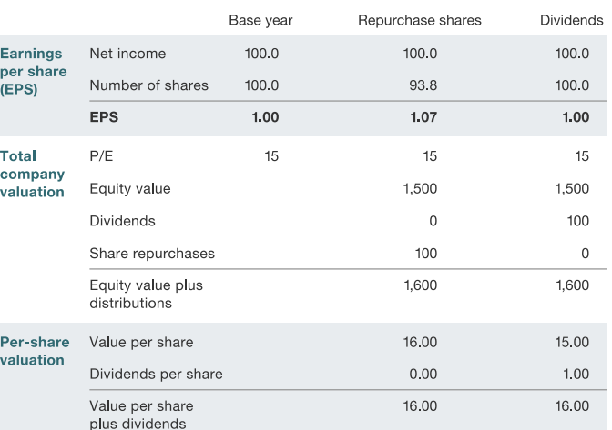
Buybacks and EPS

Slide 26
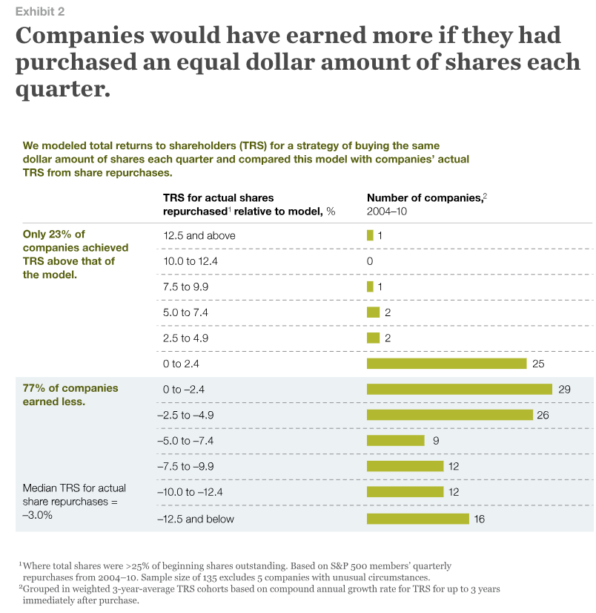
Buybacks: Can Managers Time the Market?
Source: Jiang & Koller, 2011

Slide 27
Buybacks: Can Managers Time the Market?
Little is known about the price firms pay for stock repurchases. Using a data set of all U.S. repurchases from 2004 to 2011, we compare the actual average price paid monthly in a repurchase with the average market price for the same stock over various horizons. We find that firms repurchase stock at a significantly lower price than the average market price in all sample years. Less frequent repurchasers, firms that repurchase when insiders buy on their own account, and firms that experience low stock returns prior to the repurchase obtain significantly lower prices. After controlling for risk factors, repurchasing firms earn positive returns. Infrequent repurchasers earn a significantly higher return up to three years following the actual repurchase. Dittmar & Field (2015)

Slide 28
Dividends & Repurchases Issues
Signaling: Why might stock rise after a repurchase announcement?
Dividend smoothing
Firms are reluctant to cut dividends, so they prefer to slowly increase them over time
Earnings shocks are transitory, and firms would rather do a repurchase with these shocks
Executive stock options
Call options lose value after dividend payout, so executives/owners prefer repurchases
Executive ownership
Restricted stocks do not participate in repurchase offers so they get more of the company after a repurchase, but may not get dividends
Increased leverage to fund repurchases
Investor preferences
Behavioral finance demonstrates than unsophisticated small investors prefer dividends when it would have been more beneficial (tax shield) if they sold shares instead
Fund charter exclusion clauses
Institutional charters may restrict them to holding ONLY dividend paying stocks

